Slide 1
Collaborative Filtering
Arunabh Singh – W9D2 July 2020 Cohort

Slide 2

What Is Collaborative Filtering?#
Collaborative filtering is a technique that can filter out items that a user might like on the basis of reactions by similar users.
It works by searching a large group of people and finding a smaller set of users with tastes similar to a particular user. It looks at the items they like and combines them to create a ranked list of suggestions.

Slide 3
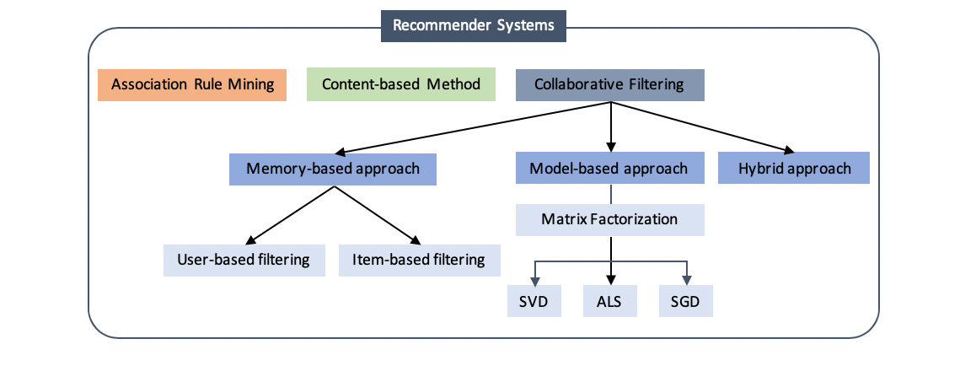
Types of Recommender Systems

Slide 4
Association Rule Mining Revision
First step is to generate an itemset like {Bread, Egg, Milk}
Second step is to generate a rule from each itemset like {Bread → Egg, Milk}, {Bread, Egg → Milk}
Frequent itemsets are the ones which occur at least a minimum number of times in the transactions.
Generate all frequent itemsets (support ≥ minsup) having only one item.
Next, generate itemsets of length 2 as all possible combinations of above itemsets.
Then, prune the ones for which support value fell below minsup.
Now generate itemsets of length 3 as all possible combinations of length 2 itemsets (that remained after pruning) and perform the same check on support value.

Slide 5
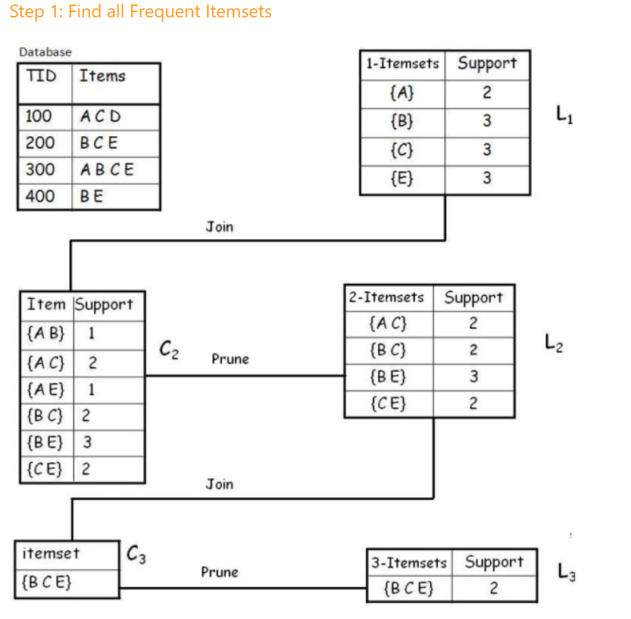
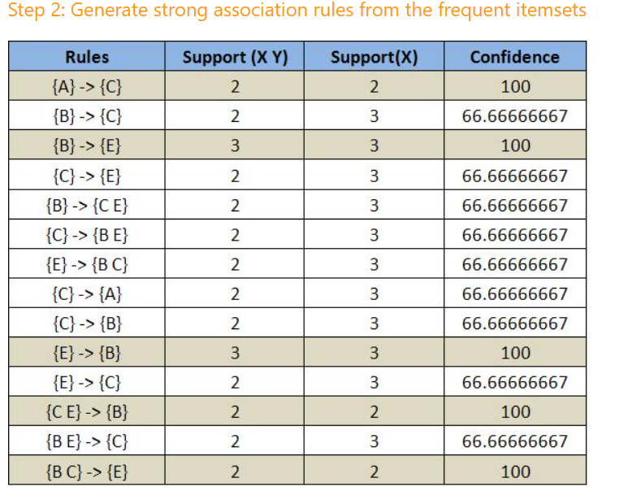
Steps to Perform Apriori

Slide 6
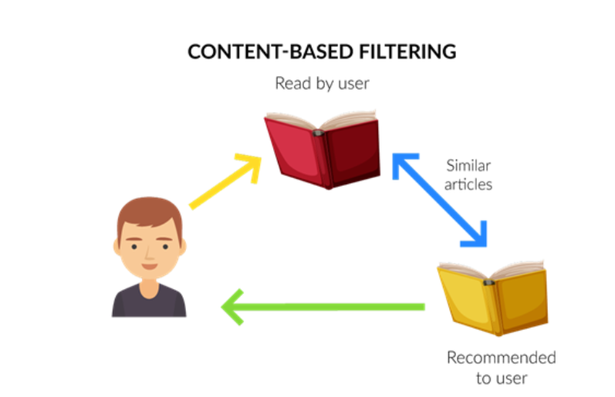
Content Based Recommendation Revision
If you read specific articles.
The representations of these articles as vectors will be similar to some other article representations as vectors.
A measure like cosine similarity is used to find similar articles.
These similar articles are then recommended to you if you haven’t read them to improve your engagement with the website or article medium.

Slide 7
Collaborative Filtering: Memory Based Approach
Memory-based collaborative filtering computes similarities between users or items and predicts a new rating for an item by taking the weighted average of ratings from the similar group.
There are two types in this approach: user-based filtering and item-based filtering.
For user-based filtering: “users who are similar to a certain user also liked…”
For item-based filtering: “users who preferred a certain item also liked…”
User-based filtering first selects a user and finds users who have similar rating patterns. The recommender system then can suggest items that those similar users liked.
Item-based filtering, on the other hand, takes an item first and finds users who liked the particular item, then searches other items that those users also liked.
Which one of the two is faster ?

Slide 8
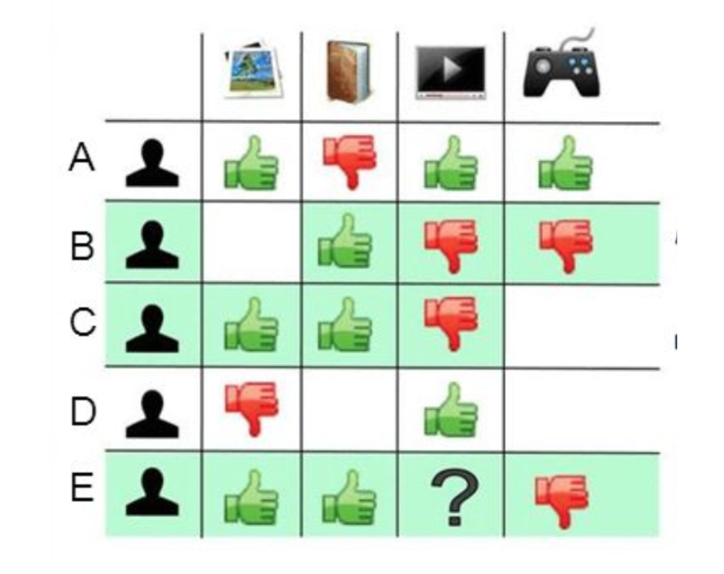
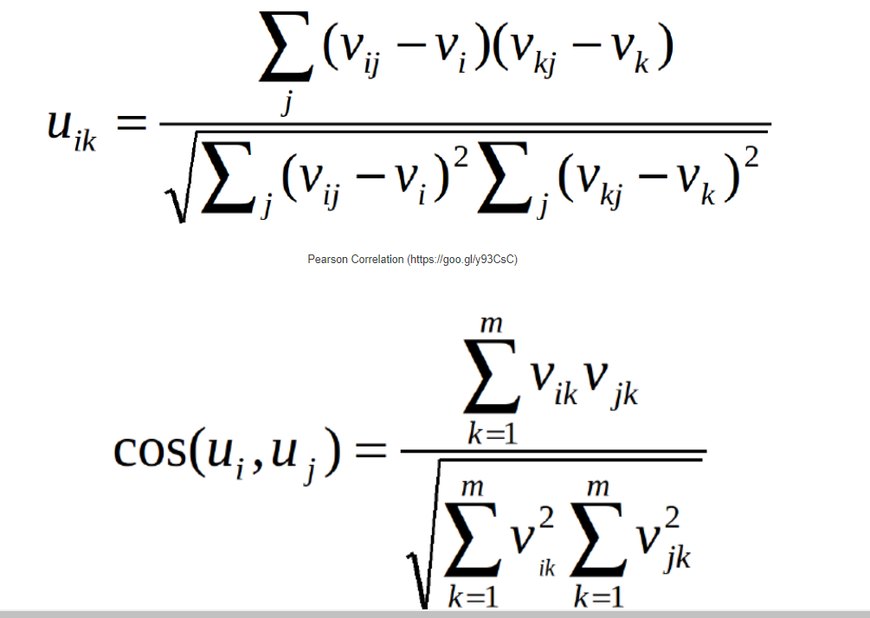
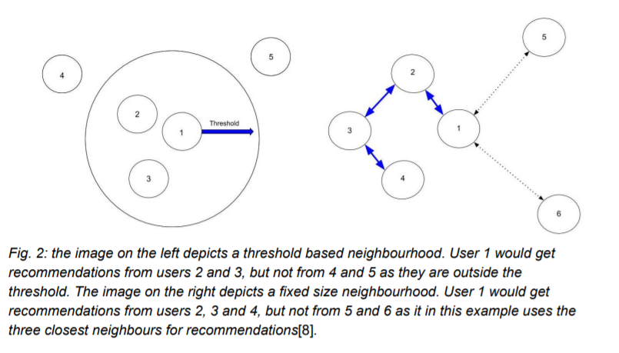
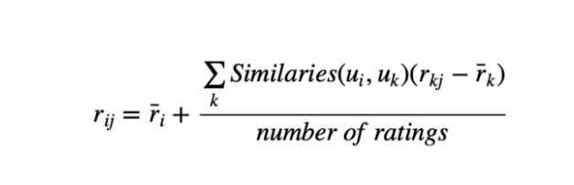
User-User Collaborative Filtering
Formula for User Similarity

Slide 9
User – User Collaborative Filtering
The process is to calculate the similarities between target user i and all other users, select the top X similar users, and take the weighted average of ratings from these X users with similarities as weights.
While different people may have different baselines when giving ratings, some people tend to give high scores generally, some are pretty strict even though they are satisfied with items. To avoid this bias, we can subtract each user’s average rating of all items when computing weighted average, and add it back for target user, shown as below.

Slide 10
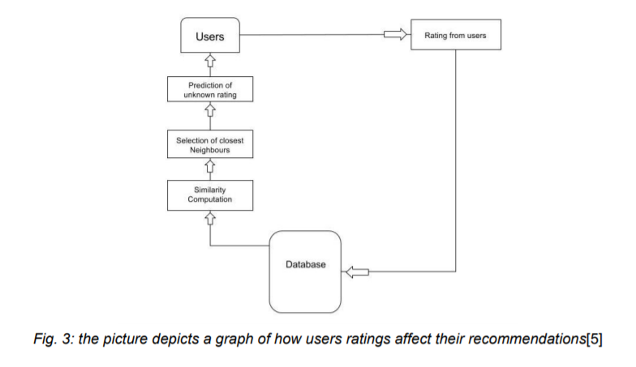
Item based collaborative filtering
Item based collaborative filtering was introduced 1998 by Amazon[6]. Unlike user based collaborative filtering, item based filtering looks at the similarity between different items, and does this by taking note of how many users that bought item X also bought item Y.
If the correlation is high enough, a similarity can be presumed to exist between the two items, and they can be assumed to be similar to one another.
This item can then be recommended to a user

Slide 11
Model Based Collaborative Filtering

Slide 12
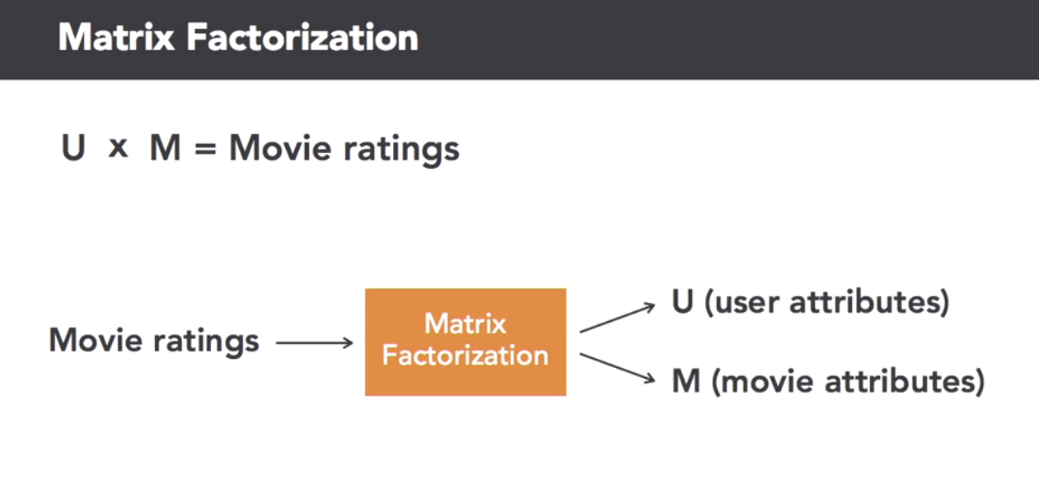
Matrix Factorization helps us reduce Movie Ratings Matrix into Movies and Users Matrix.
These Matrices will be dense representations of the Movie Ratings Matrix.

Slide 13
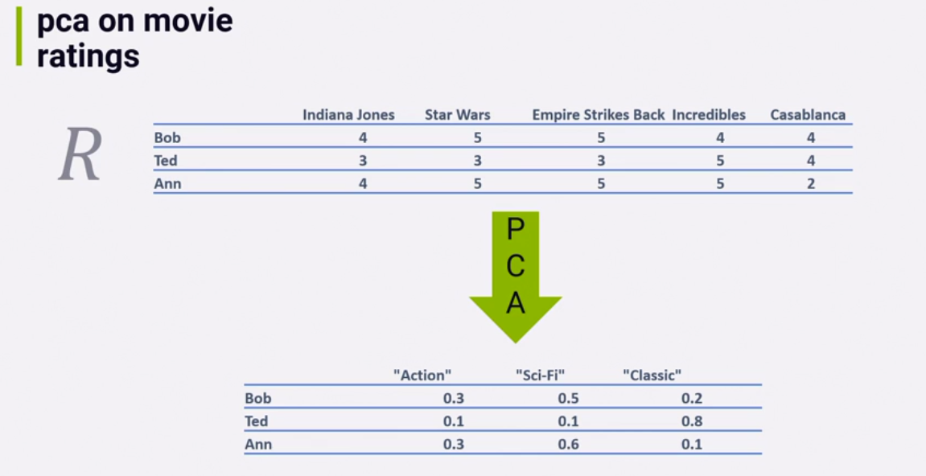
Example matrix Factorization using PCA

Slide 14
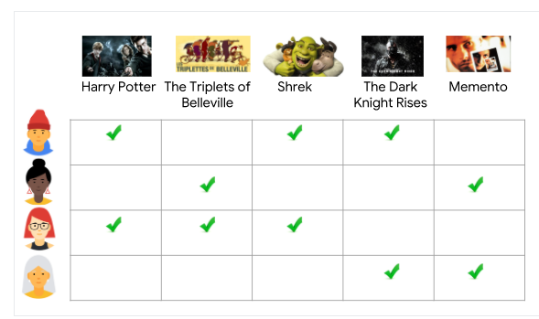
How our data looks like
We cant use PCA on this as there are missing values unlike before
Can we use this half filled matrix to get unfilled ratings for each user ? Let’s see how ML can help

Slide 15
Can we really use SVD if we cant use PCA?
This is not SVD in reality.
Actual SVD works on filled data in matrices like PCA does.
This SVD is basically an algorithm inspired from SVD.
Trivia: The algorithm used in Netflix Prize data was a variant of SVD known as SVD++ and also used Restricted Boltzmann Machines.
Other variants of SVD include Truncated SVD and Funk SVD.

Slide 16
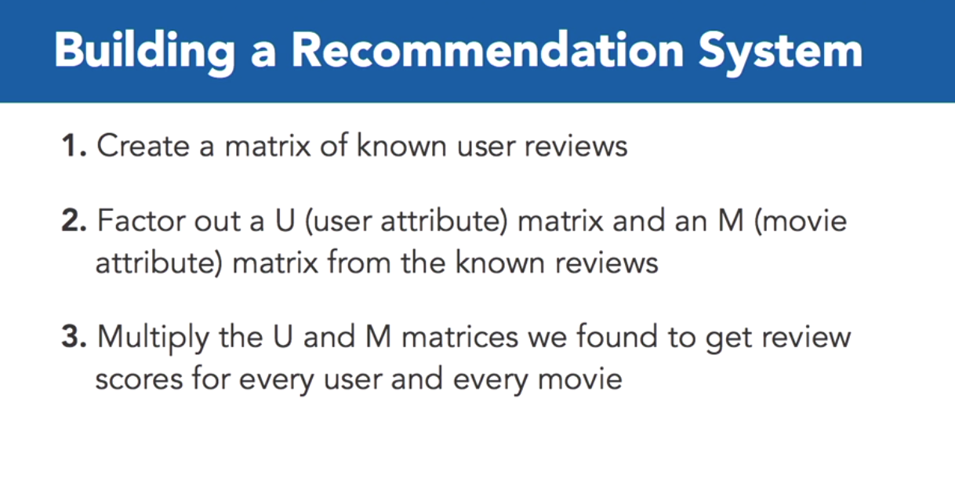
Model Based Collaborative Filtering

Slide 17
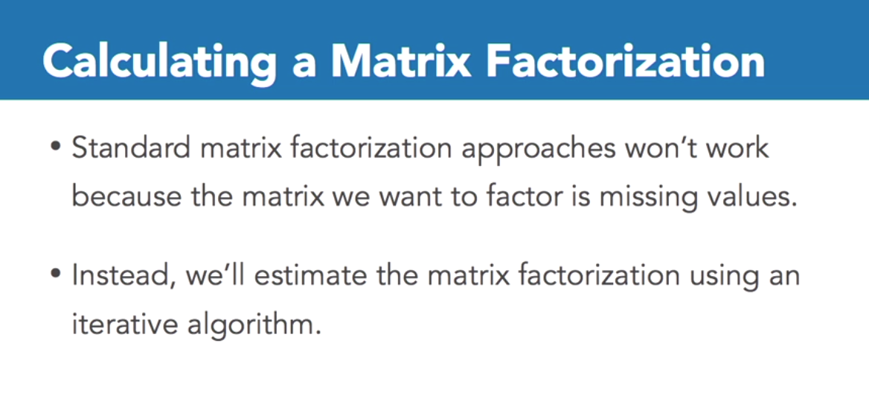

Slide 18
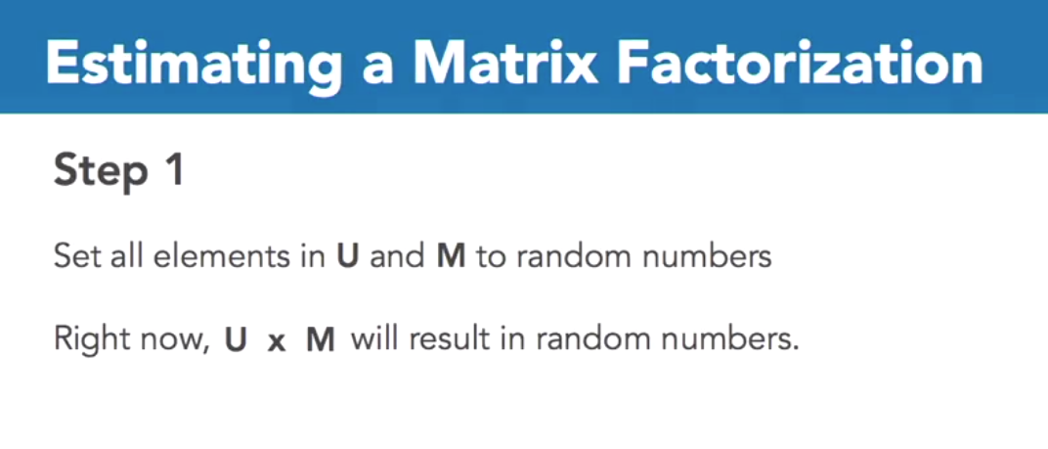
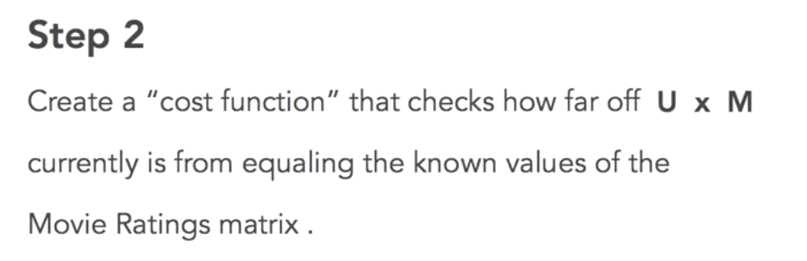

Slide 19
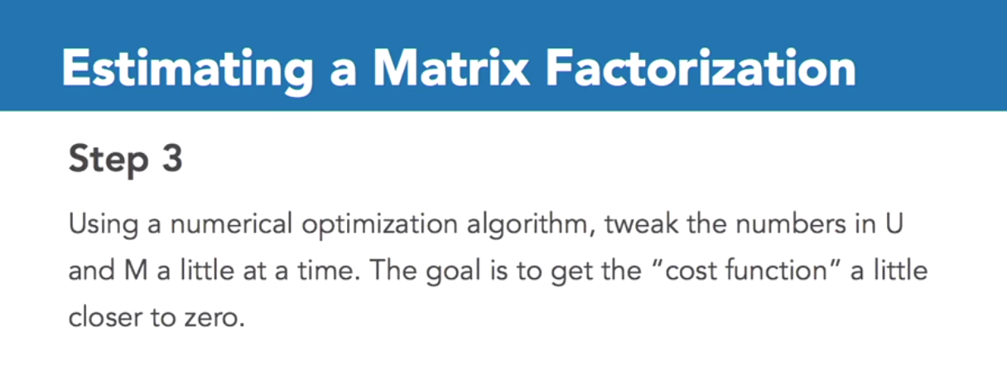
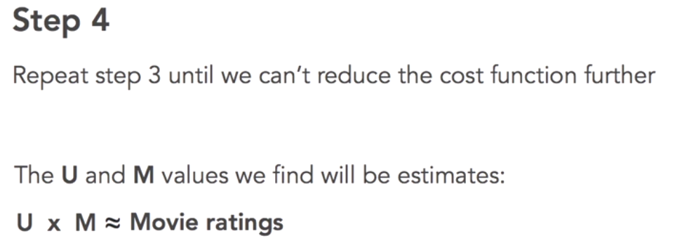

Slide 20
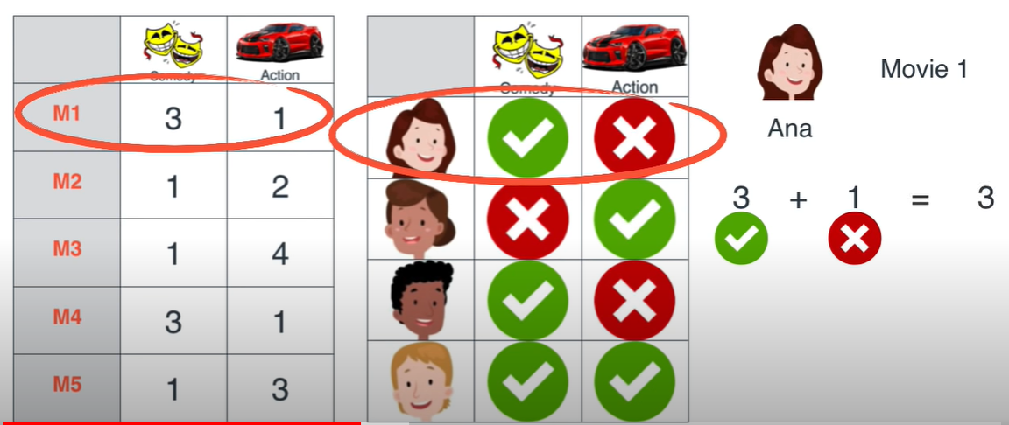
Visual Walkthrough of SVD using iterative approach
Each movies has different genres like comedy and action with a specified rating precalculated.
User also has a preference for these genres like ‘I like comedy or I dislike it’. Only the like score is added into the rating.

Slide 21
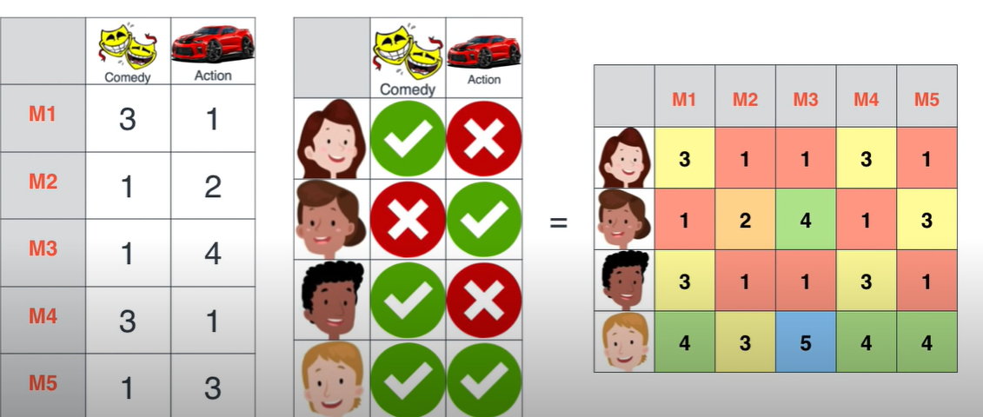
Visual Walkthrough of SVD using iterative approach
We get a final rating matrix like so.
Basically, the right matrix can be factorized into the 2 left matrices

Slide 22
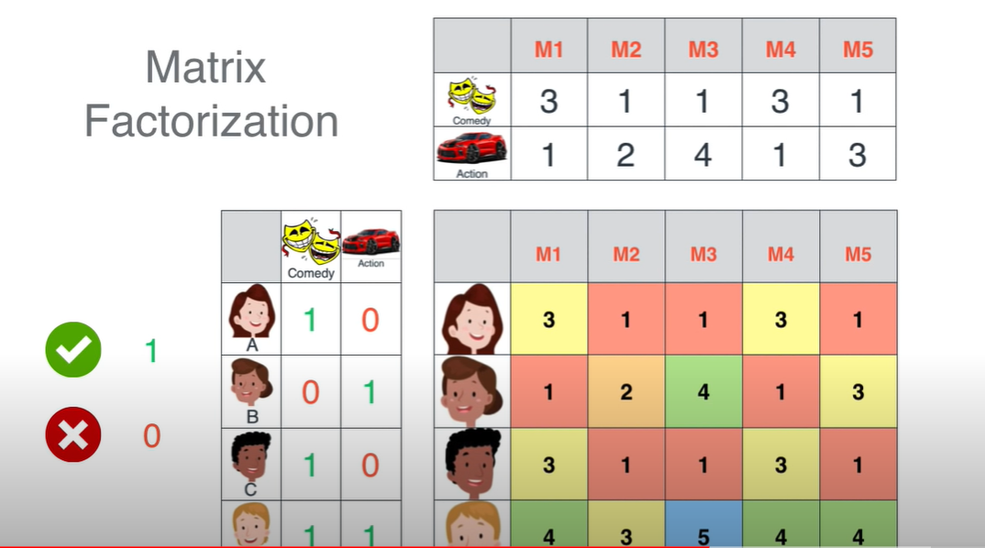
Visual Walkthrough of SVD using iterative approach
We need to get target matrix on right decomposed into 2 matrices
We need to find 2 matrices which when multiplied give us the target matrix
How do we do this?

Slide 23
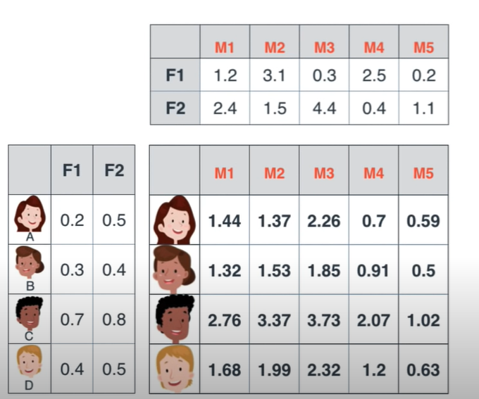
Visual Walkthrough of SVD using iterative approach
We get a final rating matrix like so.
Basically, the right matrix can be factorized into the 2 left matrices
We start with random matrices and use gradient descent to find right values to get the correct target matrix

Slide 24
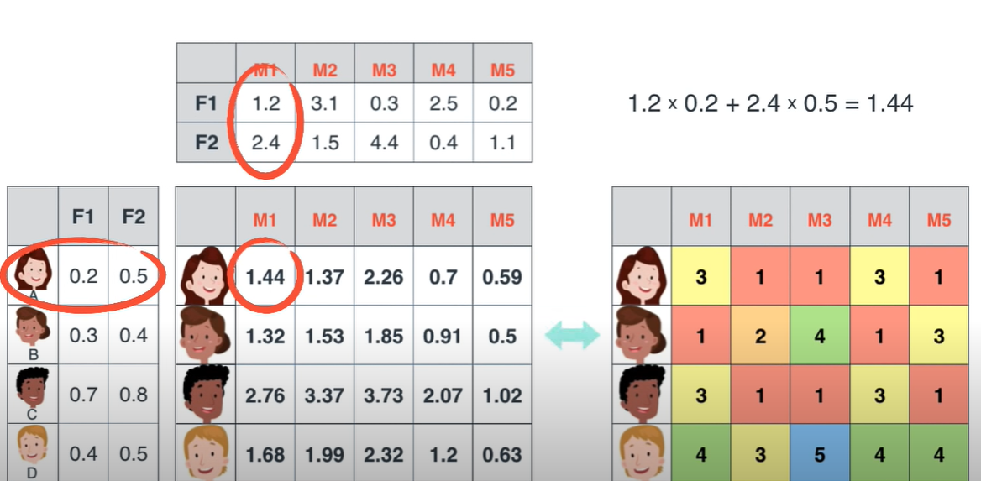
Visual Walkthrough of SVD using iterative approach
As you can see we get 1.44 instead of 3
This needs to be corrected.

Slide 25
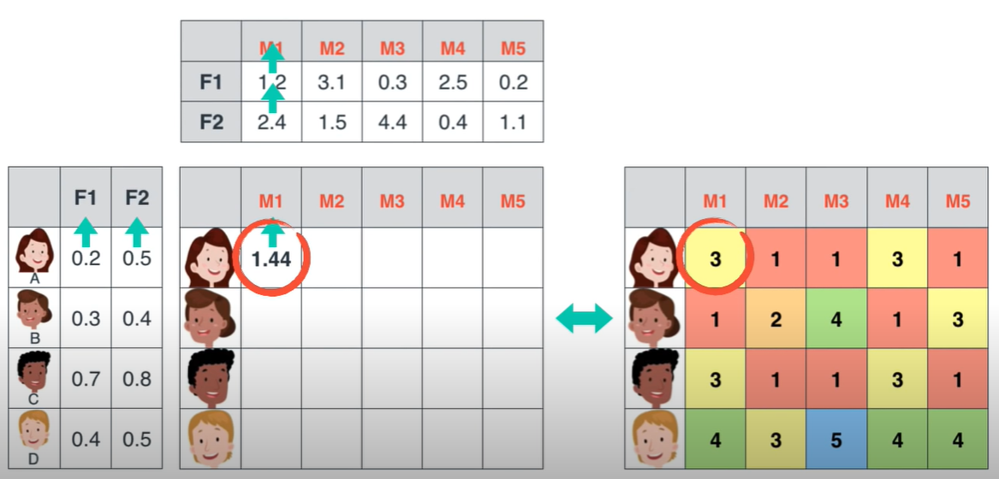
Visual Walkthrough of SVD using iterative approach
Gradient descent will update values in the non target matrices.
With enough iterations we will reach the right values.

Slide 26
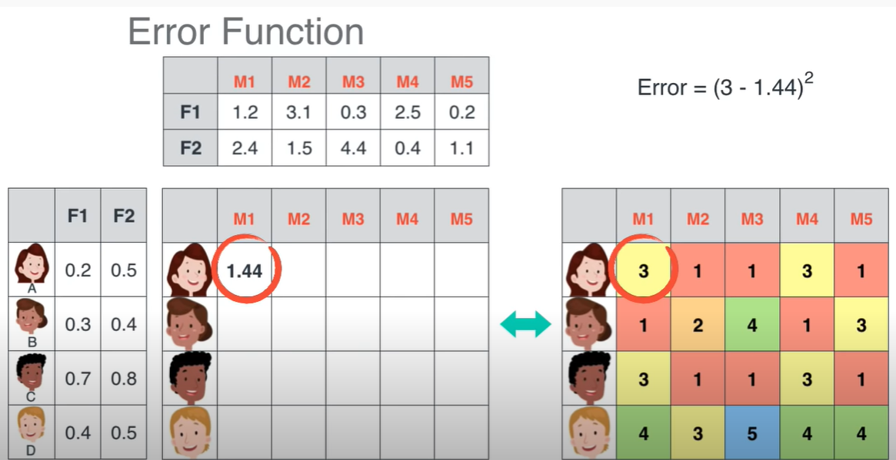
Visual Walkthrough of SVD using iterative approach

Slide 27
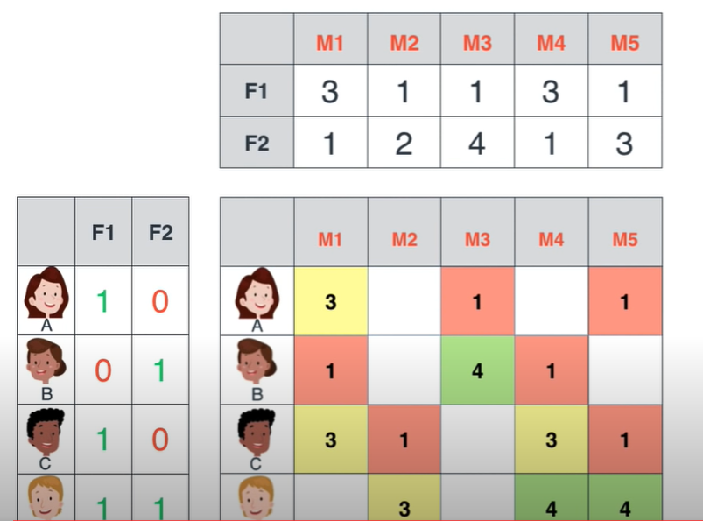
Same technique can be used to factorize empty target matrices as well.
Thus we get right factored matrices from random ones.
When multiplied these give ratings for all users.

Slide 28
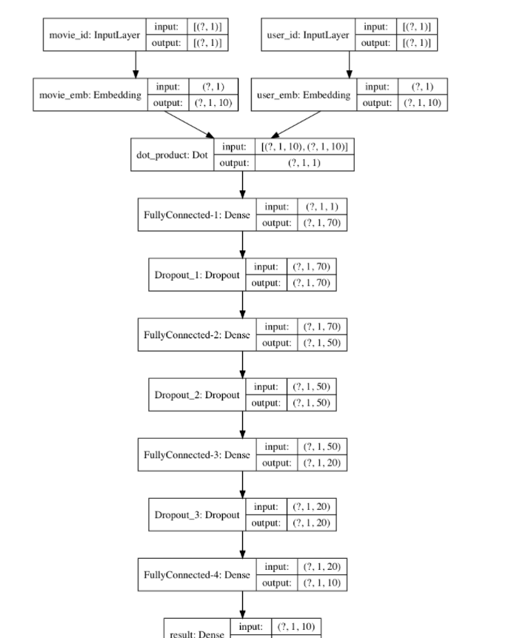
Using NN for Recommender Systems

